Slide 1
IEEE EMC Society - Region 9 Chapters Argentina, Brazil, Colombia

Slide 2
South America & Region 9 Chapters
Argentina (Buenos Aires AP/EMC Joint Chapter)
Creation: 2009
Chapter Chair : Gustavo Fano
E-mail: gustavo.gf2005@gmail.com
South Brazil Chapter (São Paulo - Brazil)
Creation: 2000 (First Chapter in Region 9)
Address: Escola Politécnica - University of São Paulo (EPUSP)
Site (Under Construction): http://sites.ieee.org/southbrazil-emcs/
Chapter Chair: Carlos Sartori e-mail: sartori@pea.usp.br
Colombia (Bogota)
Creation: 2007
Chapter Chair : Camilo Younes -Velosa
E-mail: cyounesv@unal.edu.co

Slide 3
South Brazil Chapter (São Paulo, Brazil)
South Brazil Chapter (São Paulo - Brazil)
Creation: 2000 (First Chapter in Region 9)
Address: Escola Politécnica - University of São Paulo (EPUSP)
Site (Under Construction): http://sites.ieee.org/southbrazil-emcs/
Chapter Chair: Carlos Sartori e-mail: sartori@pea.usp.br
Main Goals
Promote the EMC in Brazil , South America & Region 9
Cooperation and Interchange between Region 9 & Others
Main Events (200 – 2015)
Workshop on Biologic Effects (2001), EMC Brazil (2002, 2004, 2011, 2012)
EMC BoD Meeting (November 2002)
Invited lectures (DL, etc.)

Slide 4
South Brazil Chapter (São Paulo, Brazil)
Main Events (2016)
Workshop on EMC & Risk Assessment
Date: June 21st, 2016
Escola Politécnica – São Paulo University
Lectures:
EMC & Risk Assessment – Rio de Janeiro Tramway System
EMC & Risk Assessment – Aeronautical Requirements and Test Procedures
C. EMC & Risk Assessment– Electro-medical Equipment and Medical Installations

Slide 5
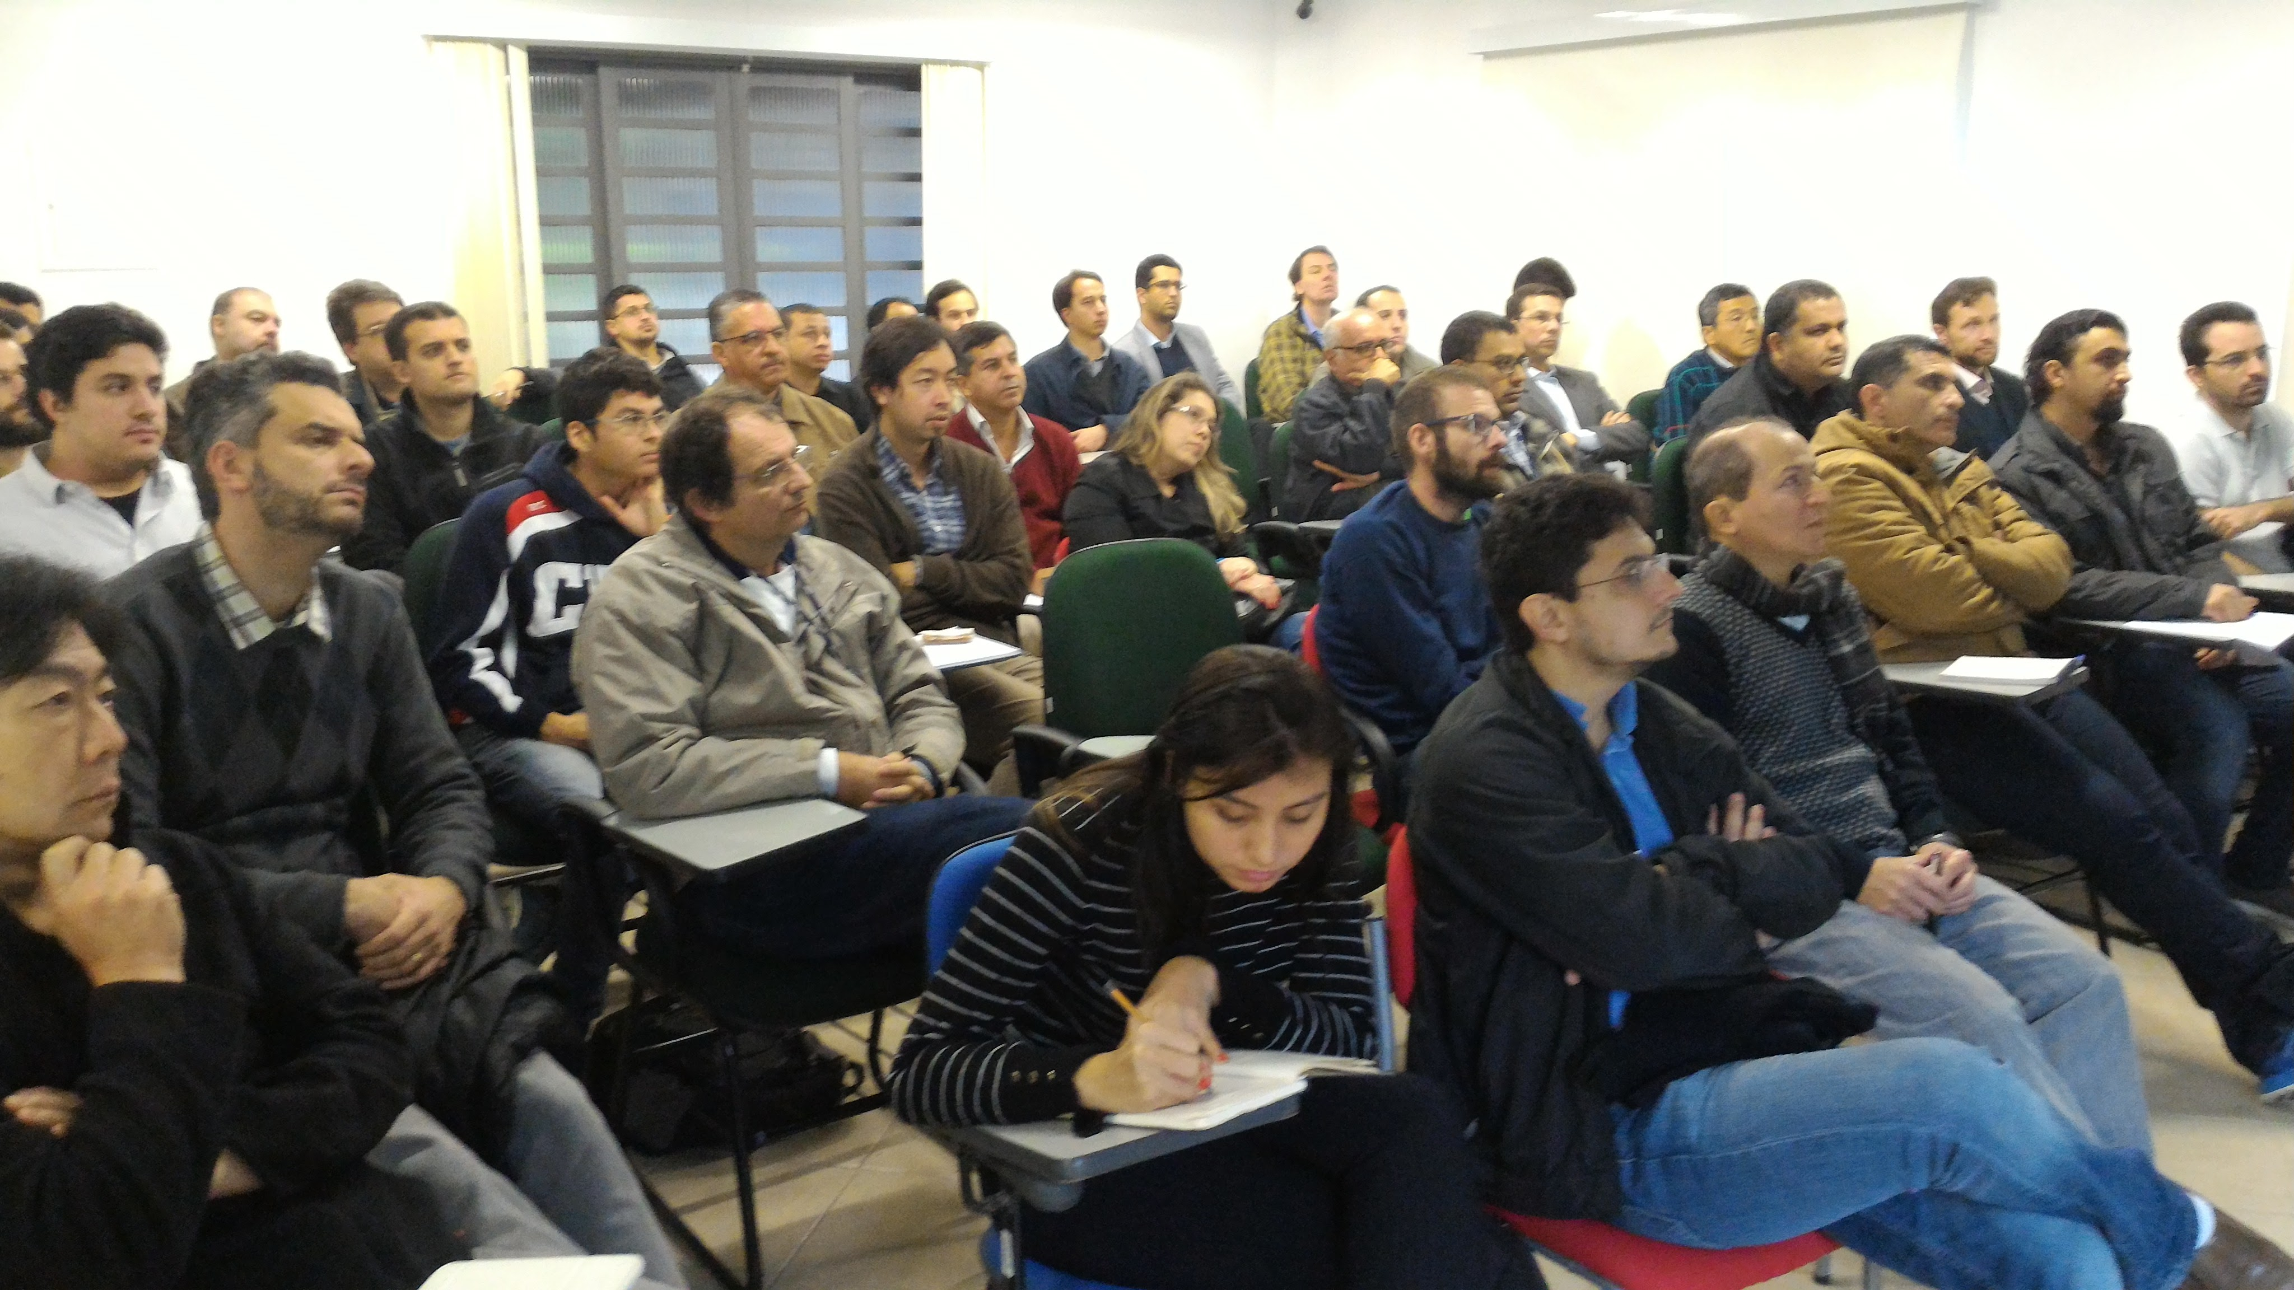
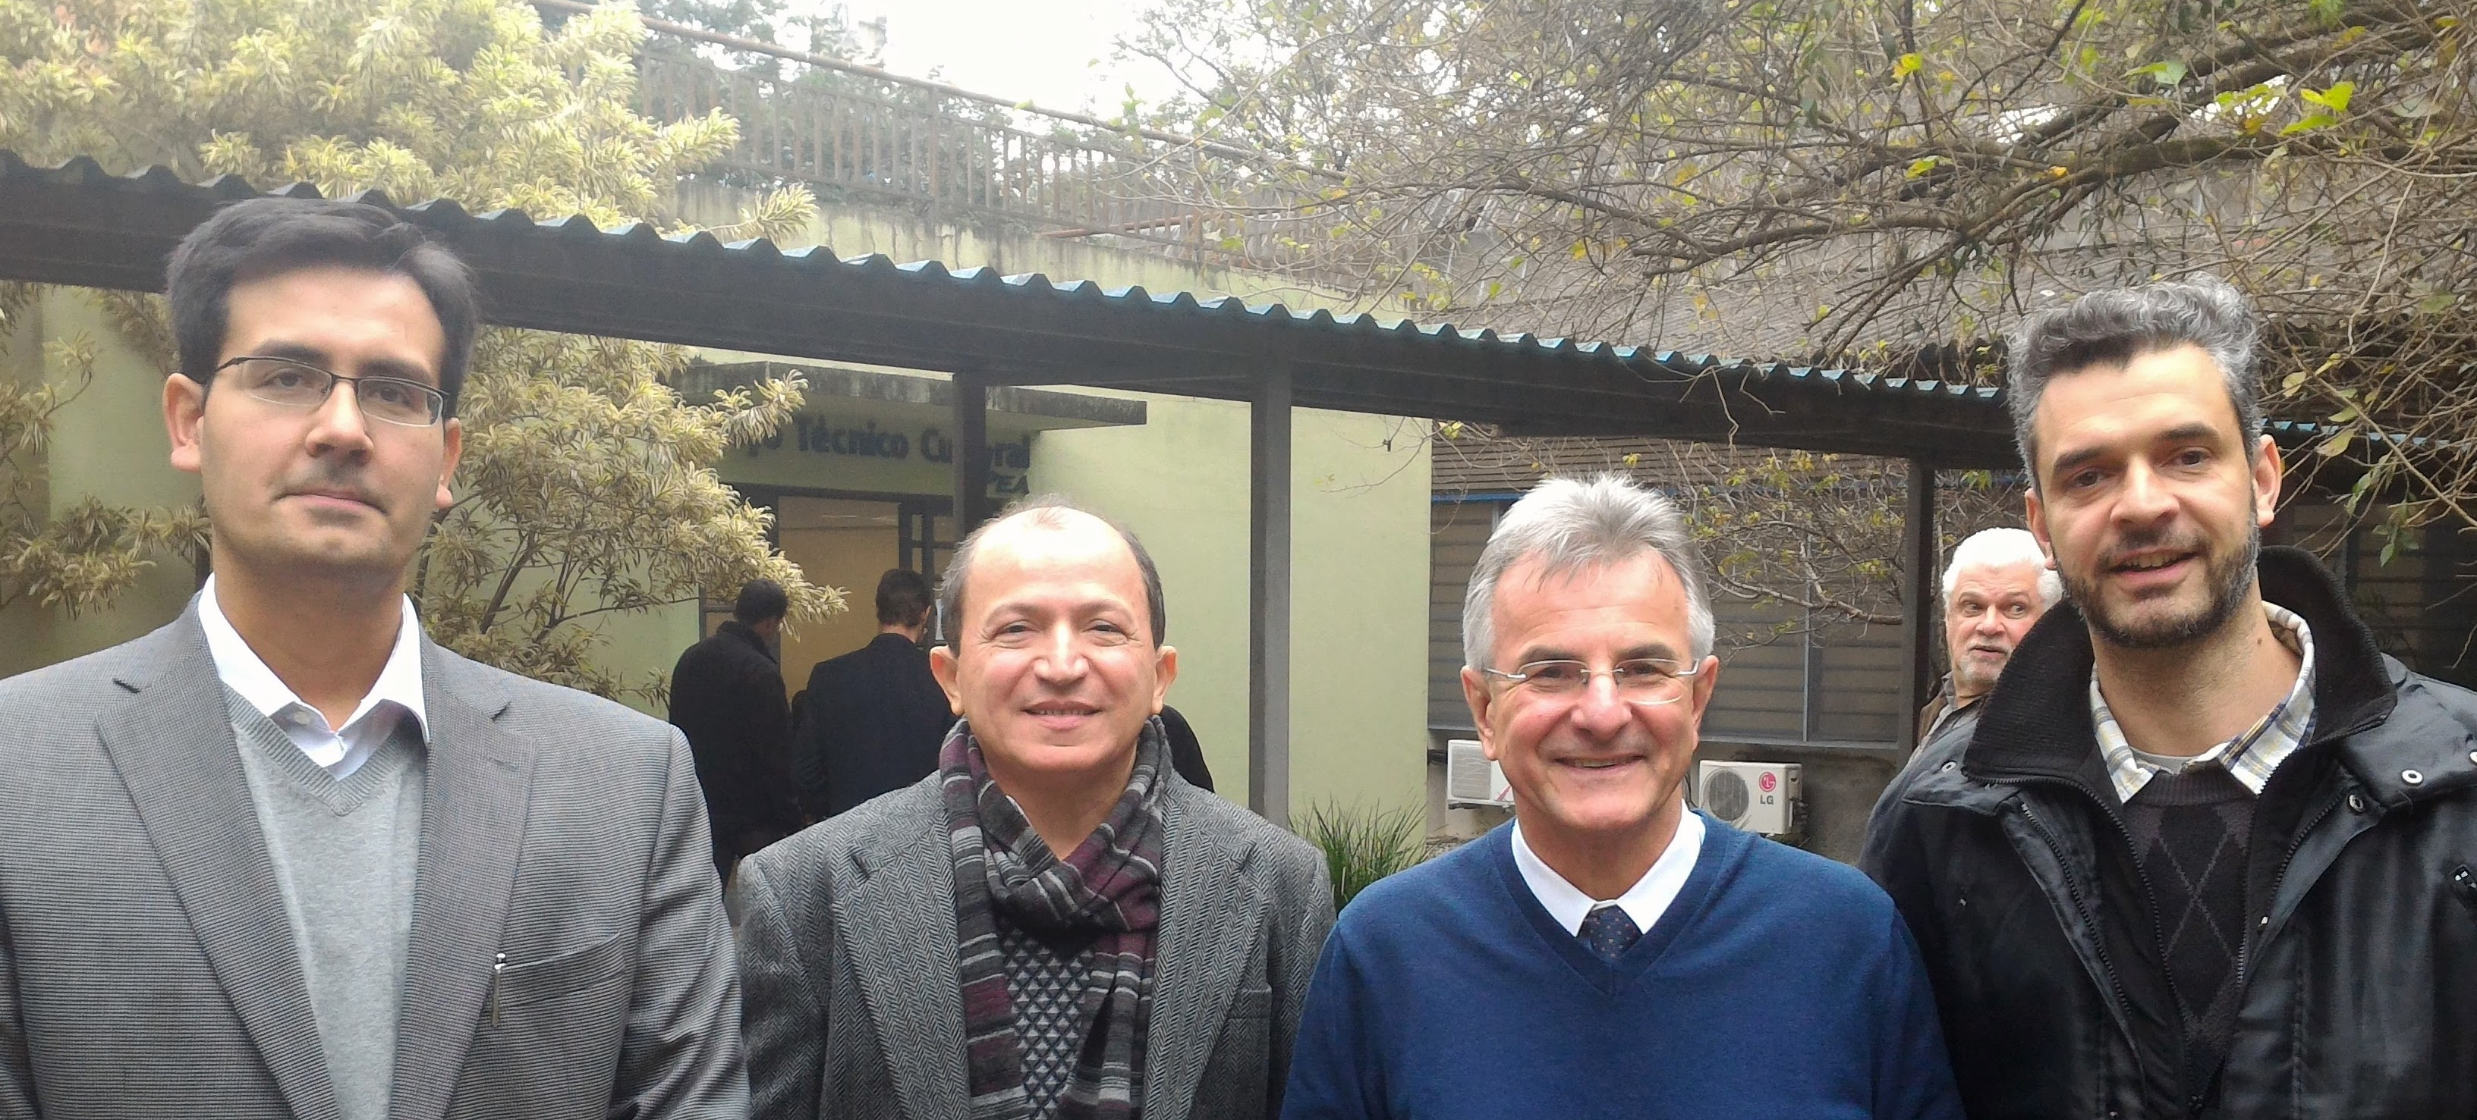
(Left & Top Right) Around 40 people attended the South Brazil EMC Chapter meeting (Right) The EMC and Risk Analysis speakers included (from left) Henrique Lemos de Faria from LACE Engenharia and ETS- Lindgren, Mario Leite - Institute of Technological Researches (IPT), Carlos Sartori from University of São Paulo (USP) - Chair of the South Brazil EMC Chapter, and Jamilson Ramos from the National Telecom Agency (ANATEL).
Future Events (October 2017)
Global EMC Conference – São Paulo Brazil
http://www.gemccon.emcss.org/

